Slide 1
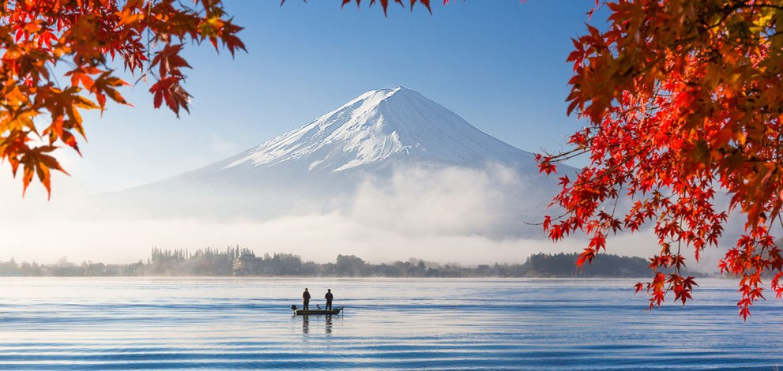
Thiện Nguyễn

Slide 2
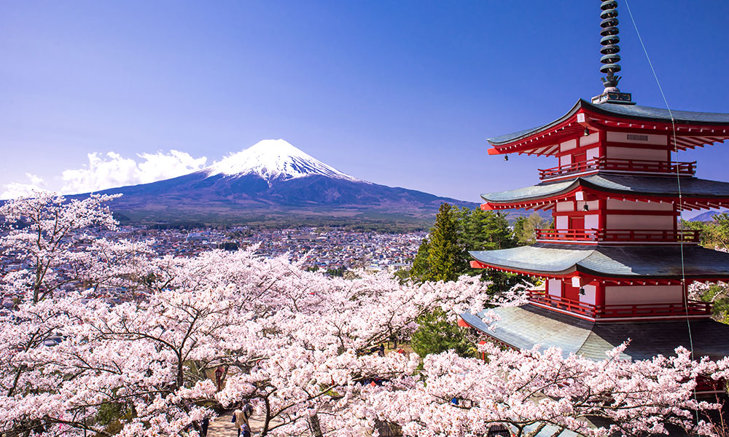
Beautiful in Japan

Slide 3
I. Introduction II. Beautiful in japan III. Facts about japan

Slide 4
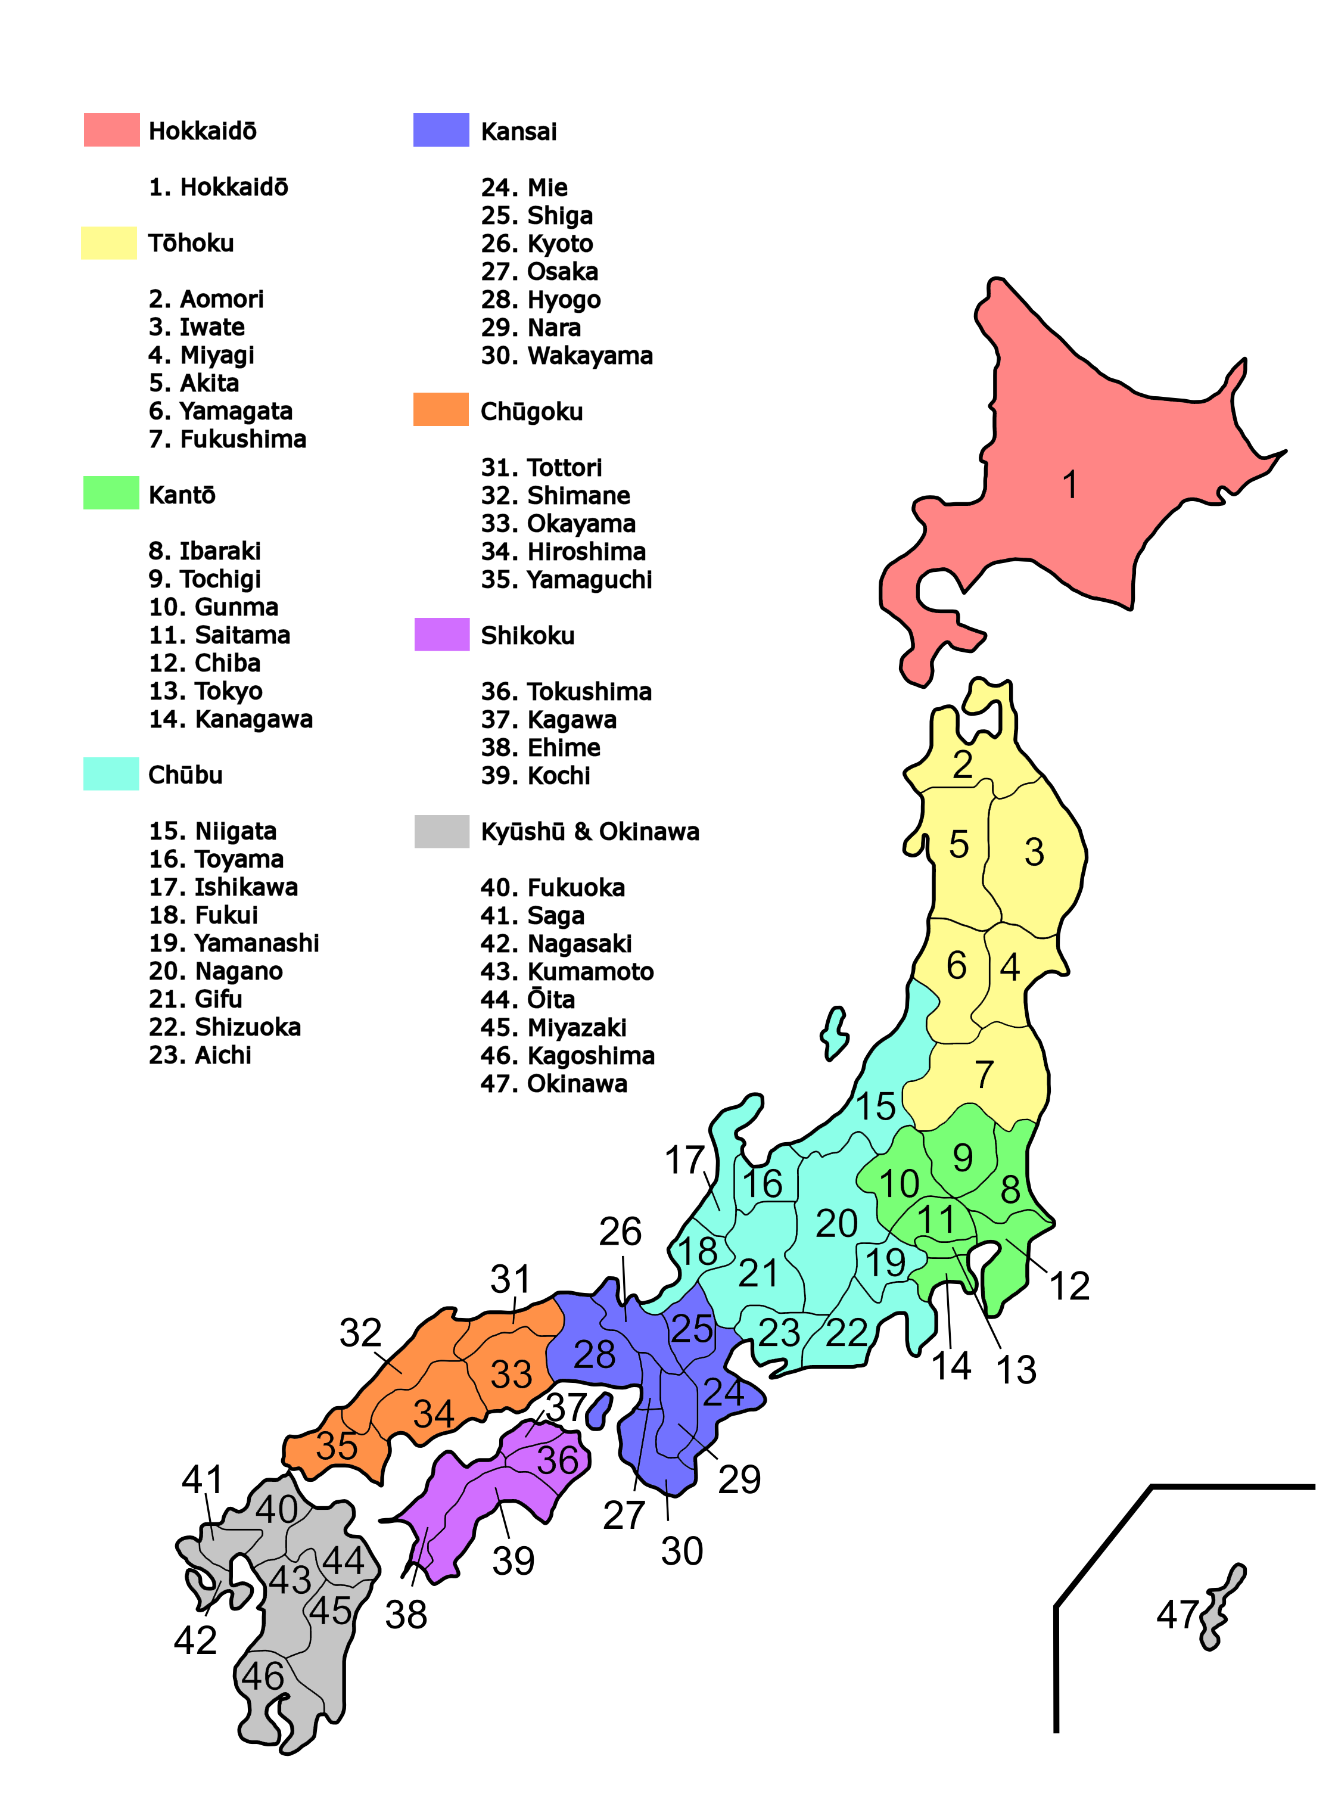
Introdution
Japan (日本)
- Is a sovereign island country in East Asia, located in the Pacific Ocean.
- The “Land of the Rising Sun”.
- There is no capital since 1956.

Slide 5
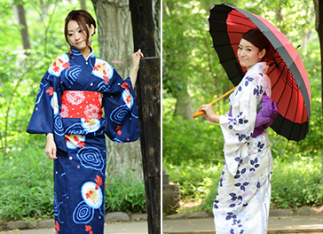
Beautiful in japan
* Traditional garment: Kimono

Slide 6
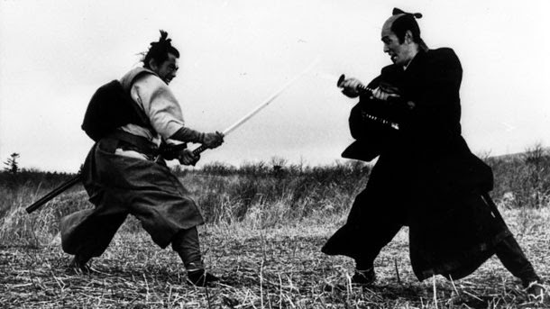
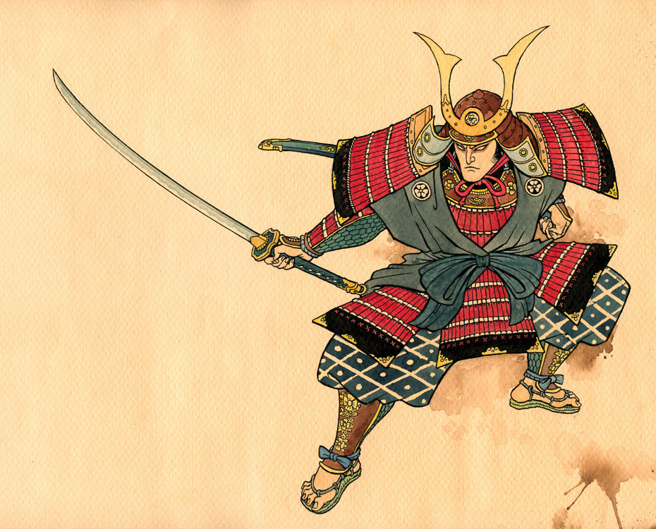
Beautiful in japan
* Japanese warriors: SAMURAI

Slide 7



Beautiful in japan
* The country of Manga, Anime,…

Slide 8
Beautiful in japan
* Traditional garment: Kimono
* Japanese warriors: SAMURAI
* The country of Manga, Anime,…
* Japanese discipline.

Slide 9
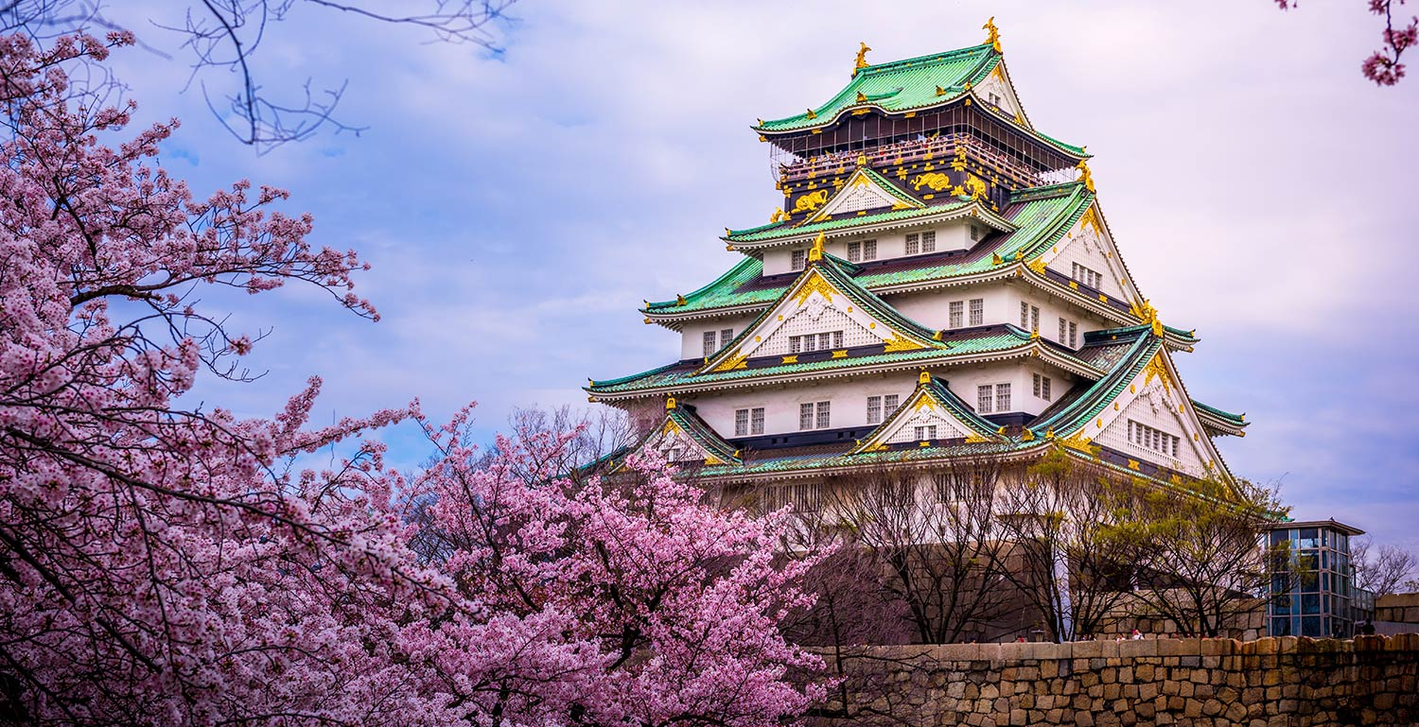
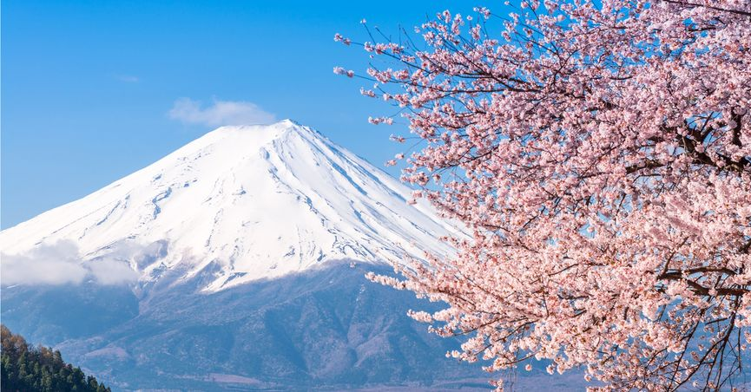
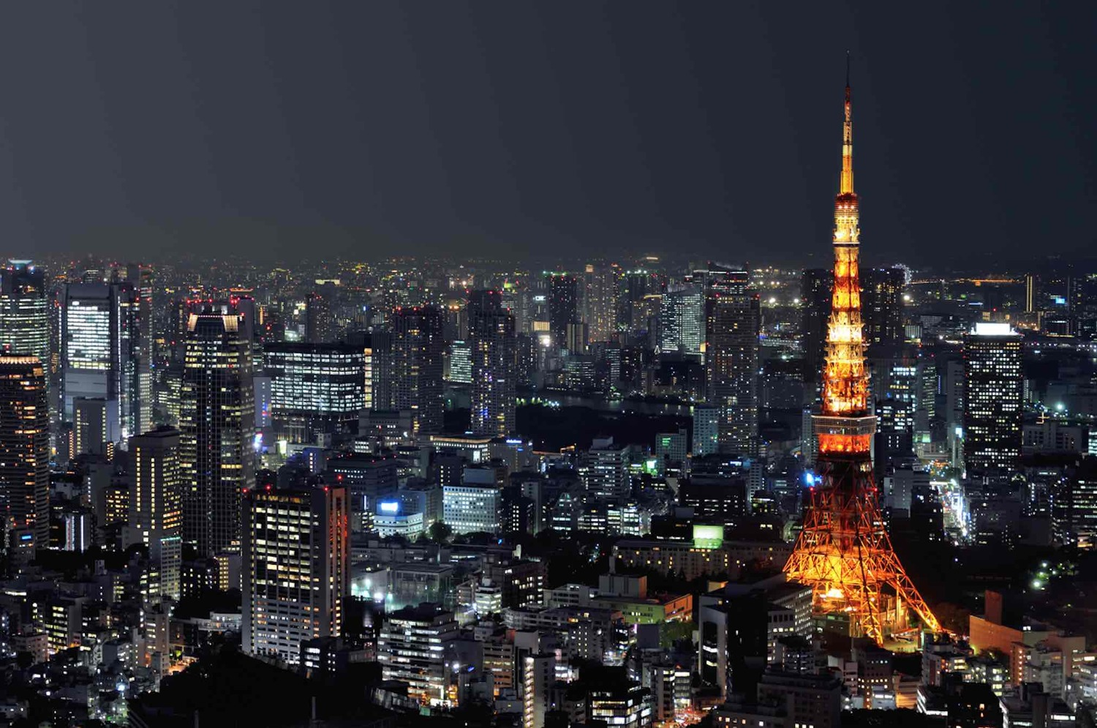
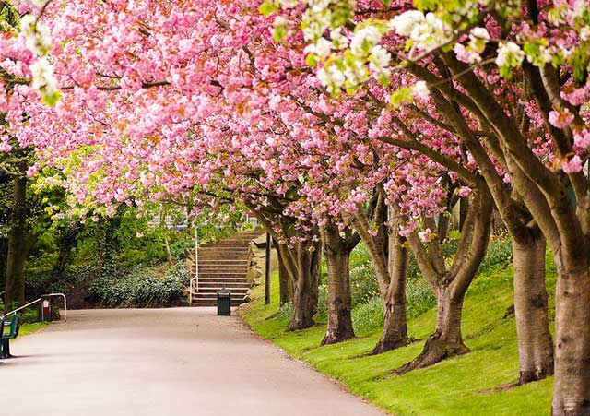
Beautiful in japan
* Very beautiful sences:

Slide 10
Facts about japan
- Japan has no capital.
- No military.
- The country of earthquake.
- Tokyo is the most populous city in the world (~34 million people).
- The world's most punctual train, the average time of the train's delay is only 18s/year.
- Japan has the lowest crime rate in the world.

Slide 11
Thanks for listening!

